Slide 1
Analysis Insights Presentation

Slide 2

About the data
The title of the data is Facebook Live Sellers in Thailand. It contains information about the Facebook pages of 10 Thai fashion and cosmetics sellers.

Slide 3
Count of different types of posts
Photo | 4288
Video | 2334
Status | 365
Link | 63

Slide 4
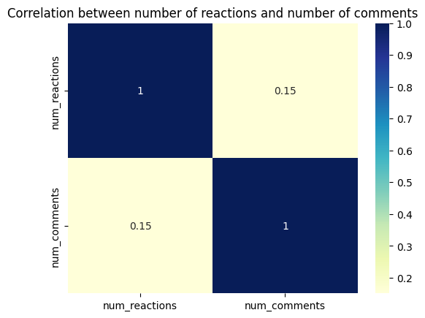
Analysis insights
The correlation between number of reactions and number of comments shows that it is positively correlated.
The number of reactions increases the number of comments and vice versa.

Slide 5
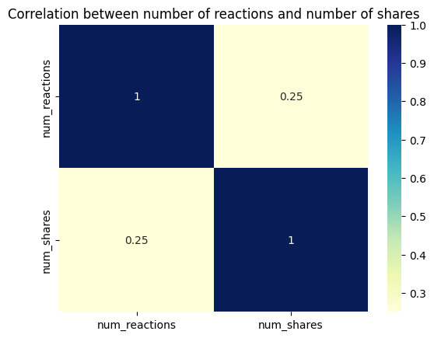
Analysis insights
The correlation between number of reactions and number of shares shows that it is positively correlated.
The number of reactions increases the number of shares and vice versa.

Slide 6
Average of number of comments
Photo | 15.993470
Video | 642.478149
Status | 36.238356
Link | 5.698413
link 5.698413 photo 15.993470 status 36.238356 video 642.478149link 5.698413 photo 15.993470 status 36.238356 video 642.478149

Slide 7
Average of number of reactions
Photo | 181.290345
Video | 283.409597
Status | 438.783562
Link | 370.142857
link 5.698413 photo 15.993470 status 36.238356 video 642.478149link 5.698413 photo 15.993470 status 36.238356 video 642.478149

Slide 8
Average of number of shares
Photo | 2.553871
Video | 115.679949
Status | 2.558904
Link | 4.396825
link 5.698413 photo 15.993470 status 36.238356 video 642.478149link 5.698413 photo 15.993470 status 36.238356 video 642.478149

Slide 9
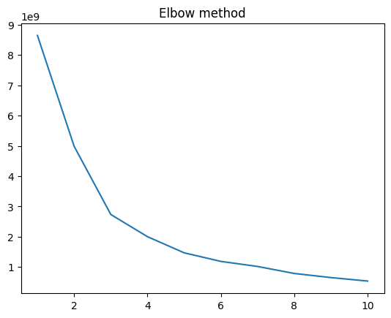
Project analysis slide 5
Determination of clusters
CLUSTERS
5
After performing the elbow method, the ideal number of clusters that are needed for optimized clustering

Slide 10
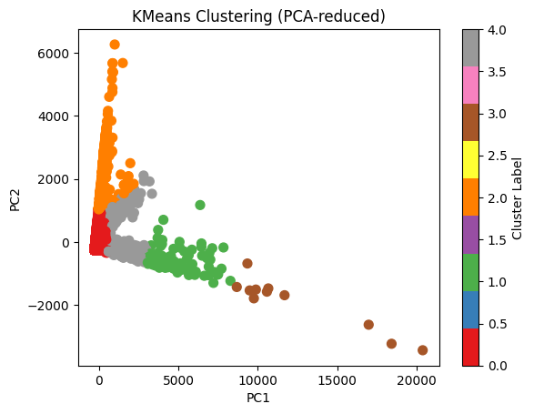
K-means clustering

Slide 11
Thank You

